Slide 1
JavaScript Clients and ASP.NET Core Web API
Notes:
https://grpc.io/

Slide 2
Objectives
JavaScript Introduction
jQuery Syntax
jQuery Selectors
jQuery Event Methods
AJAX (Asynchronous JavaScript And XML)
jQuery AJAX Methods
Demo ASP.NET Core Web API with JavaScript

Slide 3
JavaScript
JavaScript is a scripting or programming language that allows you to implement complex features on web pages - every time a web page does more than just sit there and display static information for you to look at - displaying timely content updates, interactive maps, animated 2D/3D graphics, scrolling video jukeboxes, etc.
JavaScript is the world's most popular programming language.
JavaScript is the programming language of the Web.
JavaScript is easy to learn.
This tutorial will teach you JavaScript from basic to advanced.

Slide 4
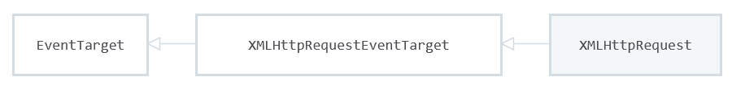
XMLHttpRequest
XMLHttpRequest (XHR) objects are used to interact with servers. You can retrieve data from a URL without having to do a full page refresh.
This enables a Web page to update just part of a page without disrupting what the user is doing.
XMLHttpRequest is used heavily in AJAX programming.
XMLHttpRequest can be used to retrieve any type of data, not just XML.
If your communication needs to involve receiving event data or message data from a server, consider using server-sent events through the EventSource interface.

Slide 5
The XMLHttpRequest Object
The XMLHttpRequest object can be used to request data from a web server.
The XMLHttpRequest object is a developers dream, because you can:
Update a web page without reloading the page
Request data from a server - after the page has loaded
Receive data from a server - after the page has loaded
Send data to a server - in the background
Notes:
https://developer.mozilla.org/en-US/docs/Web/API/XMLHttpRequest

Slide 6
jQuery Introduction - 1
jQuery is a lightweight, "write less, do more", JavaScript library.
The purpose of jQuery is to make it much easier to use JavaScript on your website.
jQuery takes a lot of common tasks that require many lines of JavaScript code to accomplish, and wraps them into methods that you can call with a single line of code.
jQuery also simplifies a lot of the complicated things from JavaScript, like AJAX calls and DOM manipulation.
The jQuery library contains the following features: HTML/DOM manipulation, CSS manipulation, HTML event methods, Effects and animations, AJAX, Utilities

Slide 7
jQuery Introduction - 2
There are lots of other JavaScript libraries out there, but jQuery is probably the most popular, and also the most extendable.
Many of the biggest companies on the Web use jQuery, such as:
Google
Microsoft
IBM
Netflix
The jQuery team knows all about cross-browser issues, and they have written this knowledge into the jQuery library. jQuery will run exactly the same in all major browsers.

Slide 8
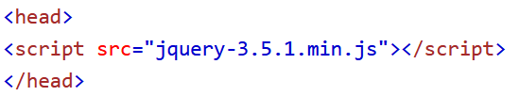
Downloading jQuery
There are two versions of jQuery available for downloading from (jQuery.com)
Production version - this is for your live website because it has been minified and compressed
Development version - this is for testing and development (uncompressed and readable code)
The jQuery library is a single JavaScript file, and you reference it with the HTML <script> tag (notice that the <script> tag should be inside the <head> section)

Slide 9
jQuery Syntax
The jQuery syntax is tailor-made for selecting HTML elements and performing some action on the element(s).
Basic syntax is: $(selector).action()
A $ sign to define/access jQuery
A (selector) to "query (or find)" HTML elements
A jQuery action() to be performed on the element(s)

Slide 10
jQuery Selectors - 1
jQuery selectors allow you to select and manipulate HTML element(s).
jQuery selectors are used to "find" (or select) HTML elements based on their name, id, classes, types, attributes, values of attributes and much more. It's based on the existing CSS Selectors, and in addition, it has some own custom selectors.
All selectors in jQuery start with the dollar sign and parentheses: $().

Slide 11
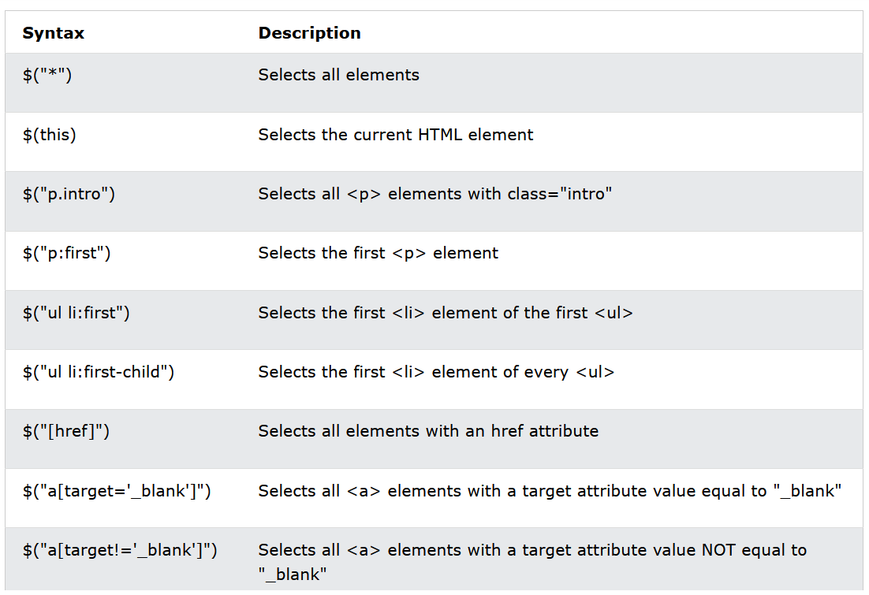
jQuery Selectors - 2
Element Selector
#id Selector
.class Selector
Examples of jQuery Selectors

Slide 12
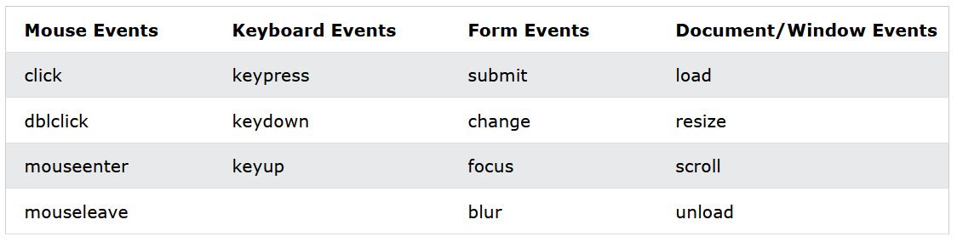
jQuery Event Methods
DOM events
jQuery syntax for event methods: $(“selector").eventmethod();

Slide 13
What is AJAX?
AJAX = Asynchronous JavaScript and XML.
In short; AJAX is about loading data in the background and display it on the webpage, without reloading the whole page.
Examples of applications using AJAX: Gmail, Google Maps, Youtube, and Facebook tabs
jQuery provides several methods for AJAX functionality.
With the jQuery AJAX methods, you can request text, HTML, XML, or JSON from a remote server using both HTTP Get and HTTP Post - And you can load the external data directly into the selected HTML elements of your web page.

Slide 14
jQuery AJAX Methods
Method | Description
$.ajax() | Performs an async AJAX request
$.get() | Loads data from a server using an AJAX HTTP GET request
$.param() | Creates a serialized representation of an array or object (can be used as URL query string for AJAX requests)
$.post() | Loads data from a server using an AJAX HTTP POST request
load() | Loads data from a server and puts the returned data into the selected element
serialize() | Encodes a set of form elements as a string for submission

Slide 15
jQuery - ajax() method
The ajax() method is used to perform an AJAX (asynchronous HTTP) request.
All jQuery AJAX methods use the ajax() method. This method is mostly used for requests where the other methods cannot be used.
Syntax: $.ajax({name:value, name:value, ... })
Notes:
https://www.w3schools.com/jquERy/ajax_ajax.asp

Slide 16
Demo ASP.NET Core Web API with JavaScript

Slide 17
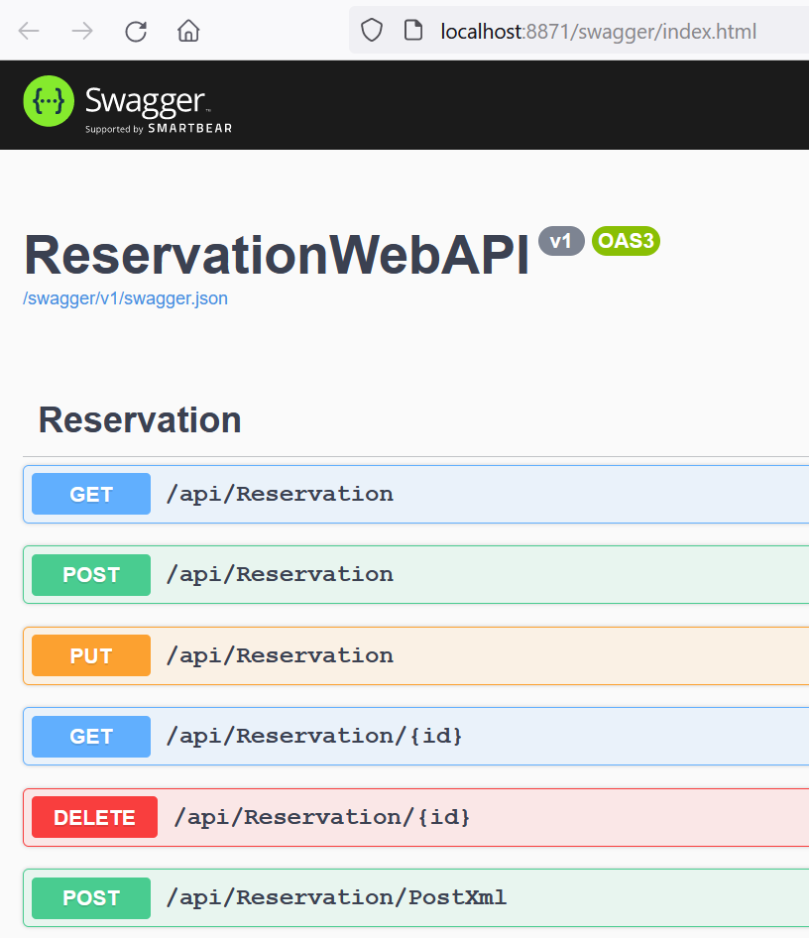
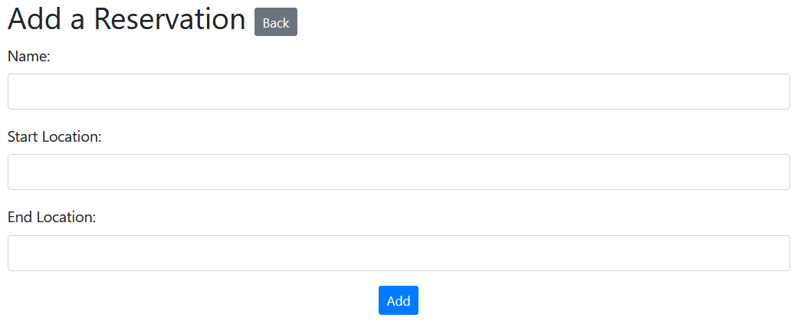
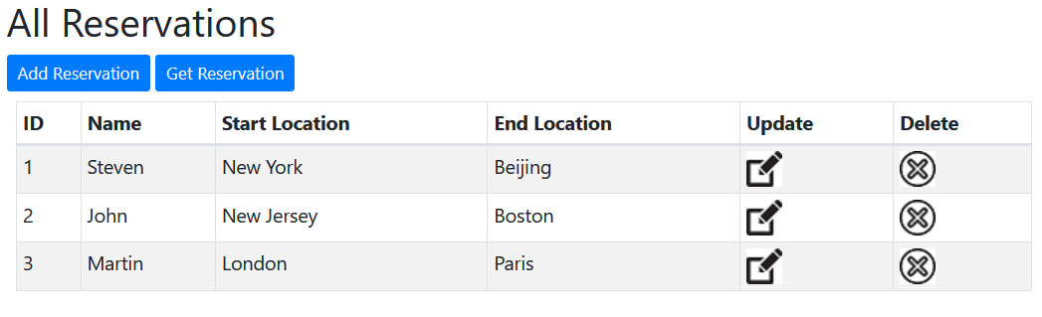
Using JavaScript to get data from Web API

Slide 18
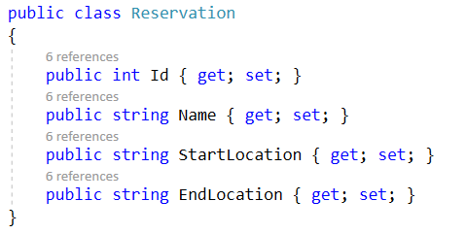
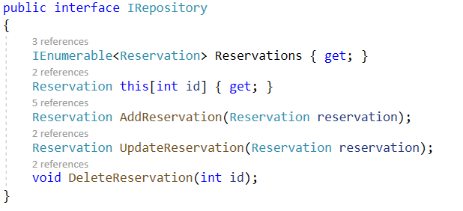
Create ASP.NET Core Web API - 1
Create ASP.NET Core Web API Project
Models and IRepository

Slide 19
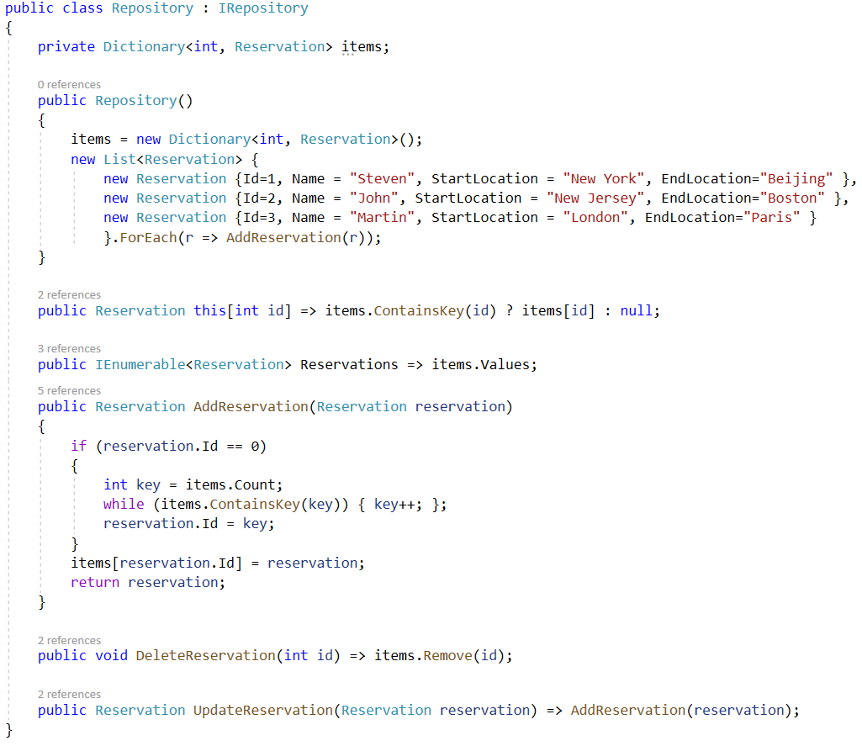
Create ASP.NET Core Web API - 2
Implement interface IRepository

Slide 20
Create ASP.NET Core Web API - 3
Implement interface IRepository

Slide 21
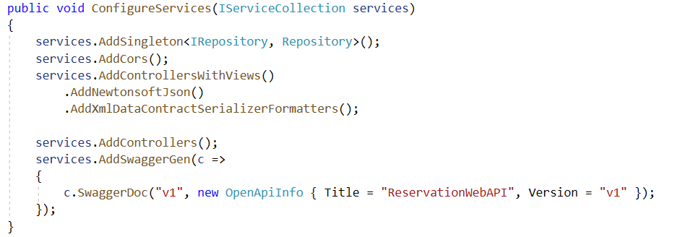
Web API Settings with Startup.cs - 1
Configure with ConfigureServices() function

Slide 22
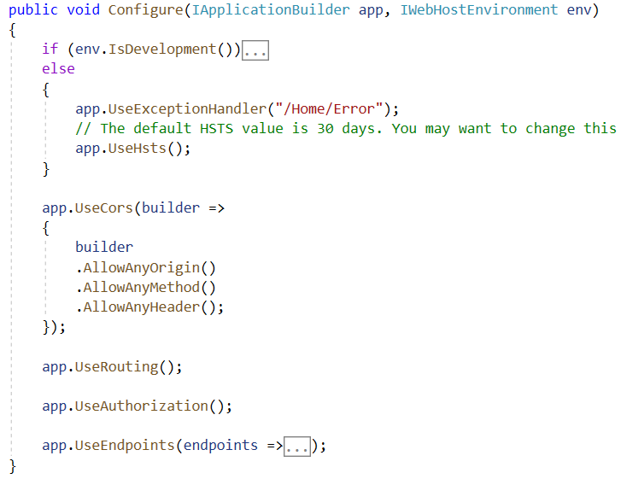
Web API Settings with Startup.cs - 2
Configure with Configure () function

Slide 23
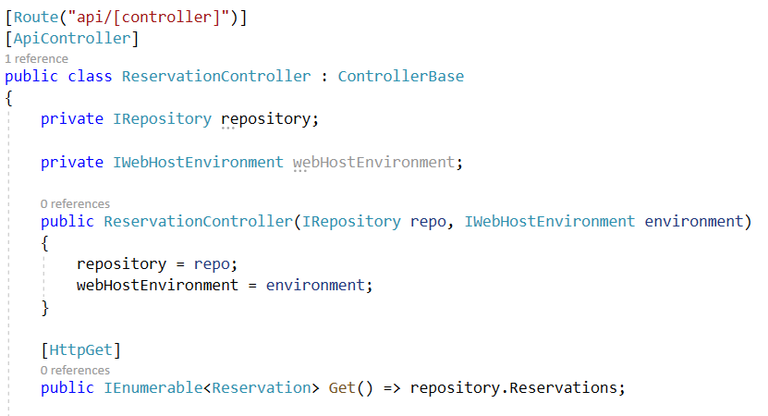
Add API Controller for CRUD actions - 1

Slide 24
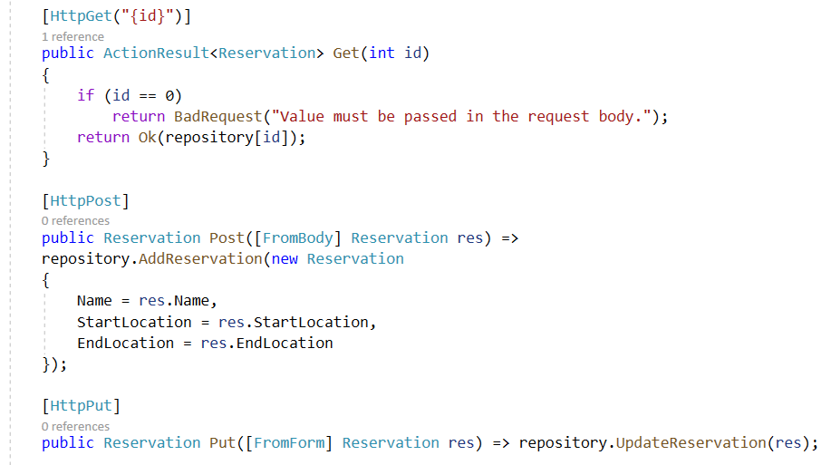
Add API Controller for CRUD actions - 2

Slide 25
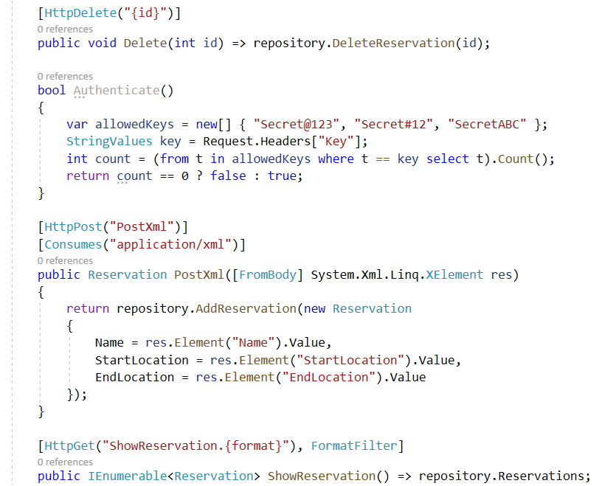
Add API Controller for CRUD actions - 3

Slide 26
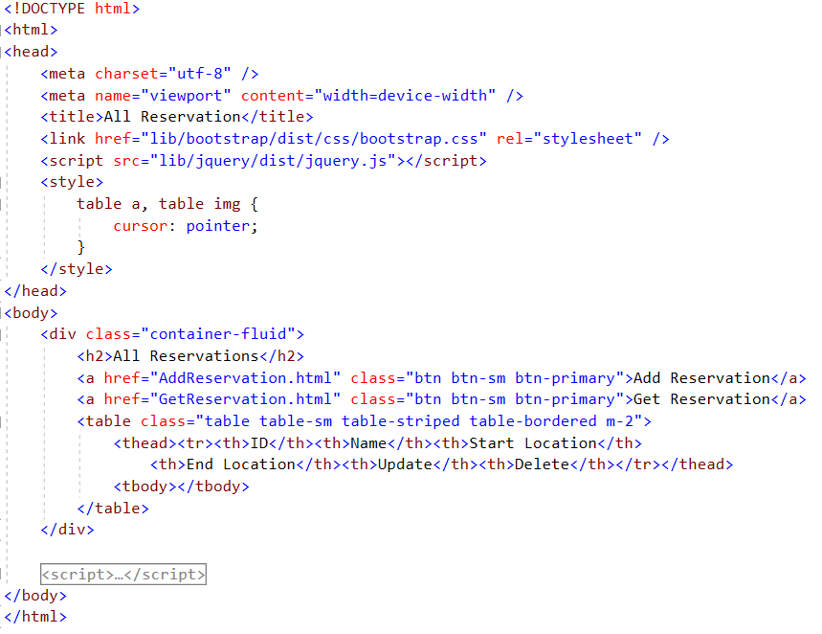
Implement JavaScript to display all data - 1
HTML for display all reservations from ASP.NET Core Web API

Slide 27
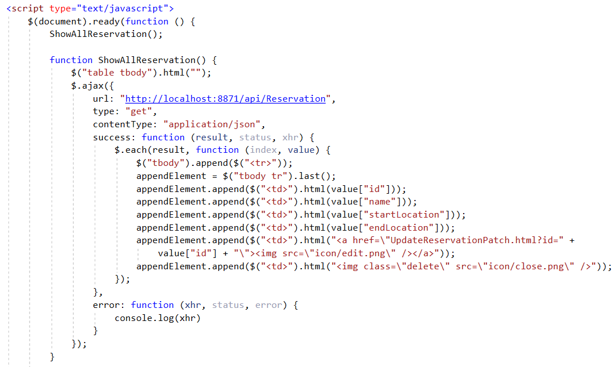
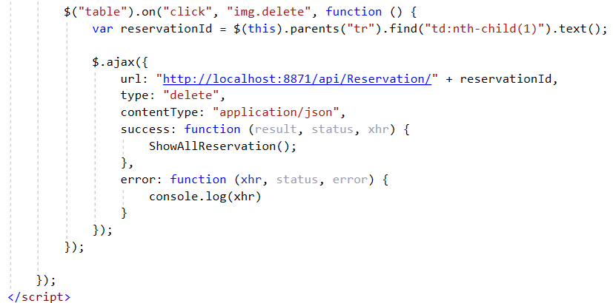
Implement JavaScript to display all data - 2
Using jQuery $.ajax() function

Slide 28
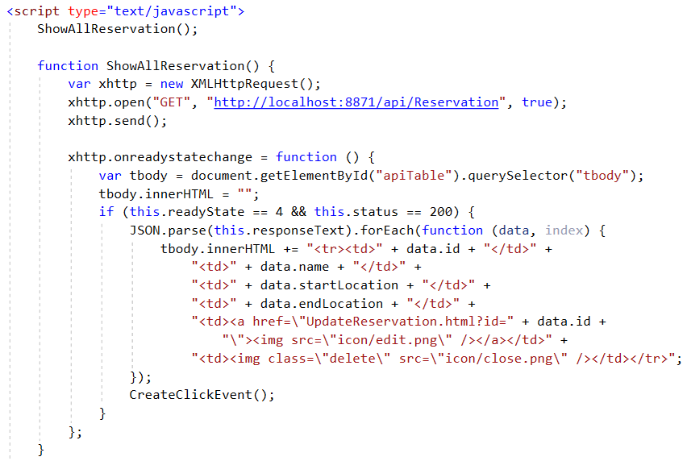
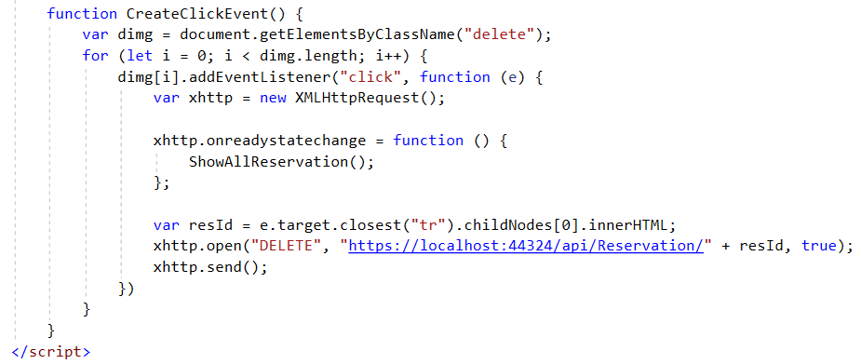
Implement JavaScript to display all data – 3
Using JavaScript XMLHttpRequest

Slide 29
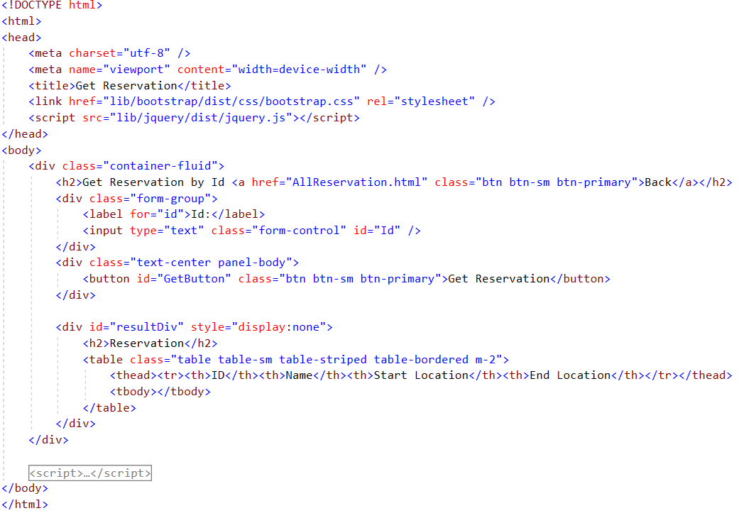
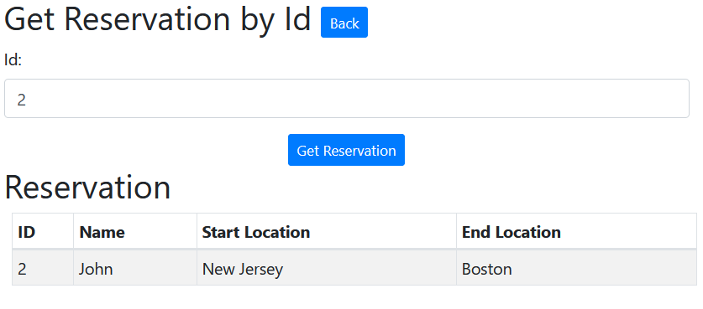
Implement JavaScript to get data by Id - 1
HTML for getting specific reservation by Id from ASP.NET Core Web API

Slide 30
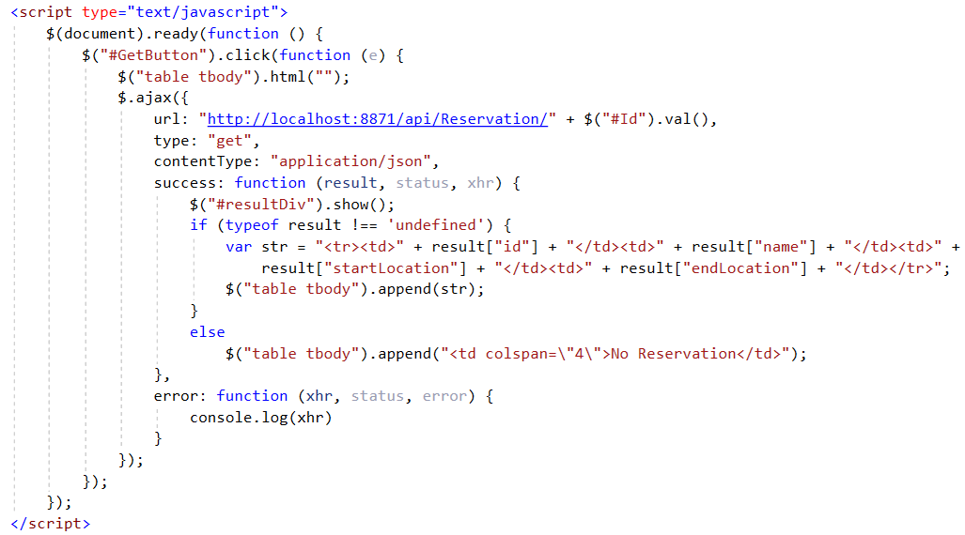
Implement JavaScript to get data by Id - 2
Using jQuery $.ajax() function to get data by Id

Slide 31
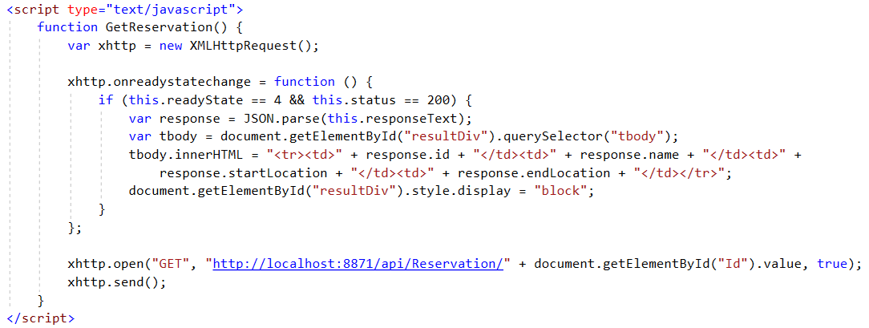
Implement JavaScript to get data by Id - 3
Using JavaScript XMLHttpRequest

Slide 32
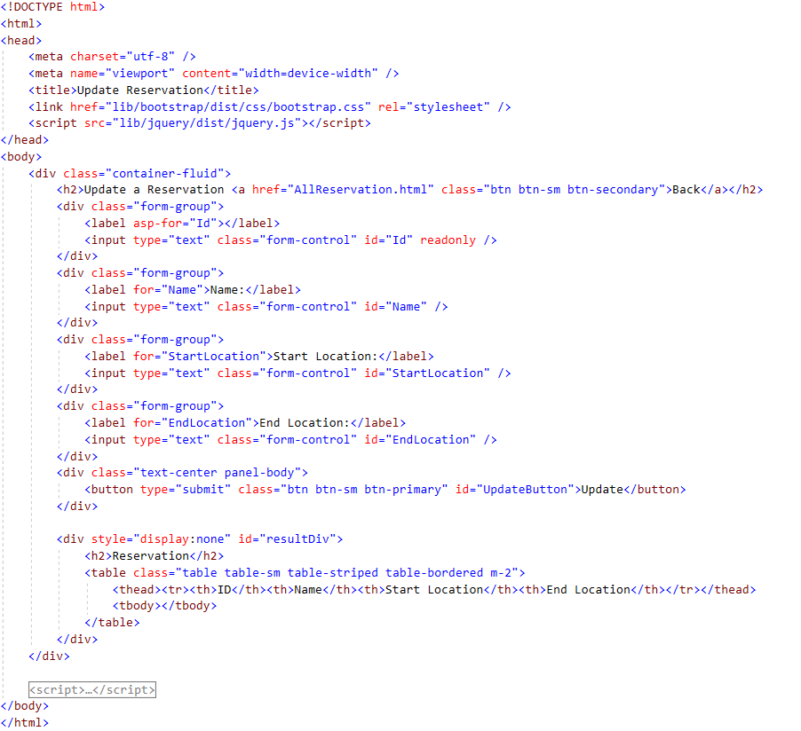
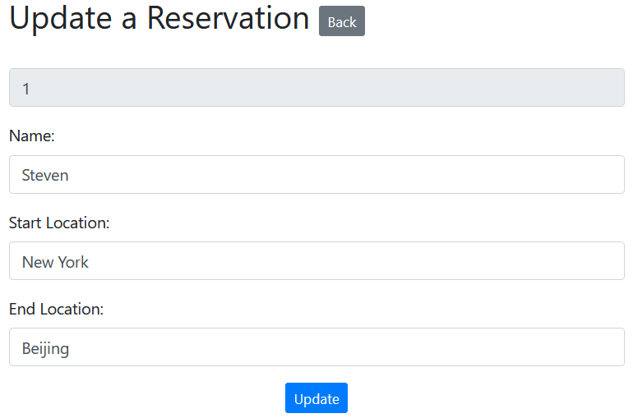
Update the existing data - 1
HTML for updating the existing reservation by Id from ASP.NET Core Web API

Slide 33
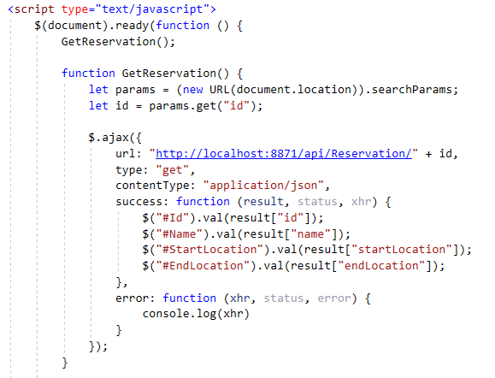
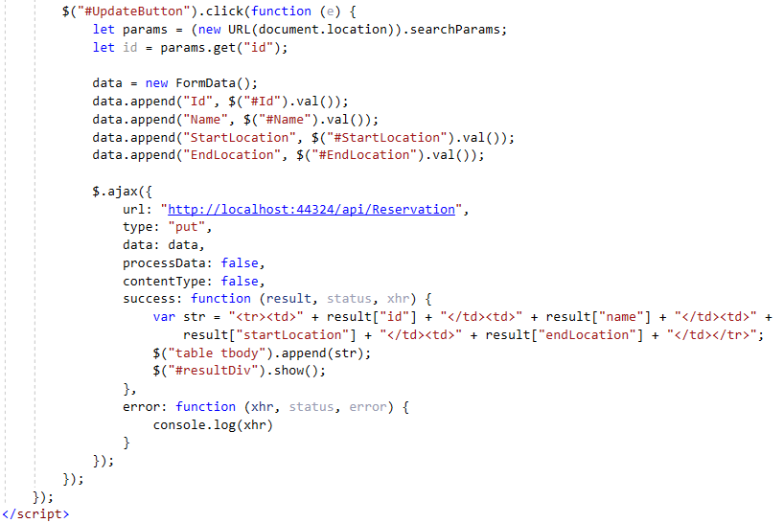
Update the existing data - 2
Using jQuery $.ajax() function to get the data by Id, then update

Slide 34
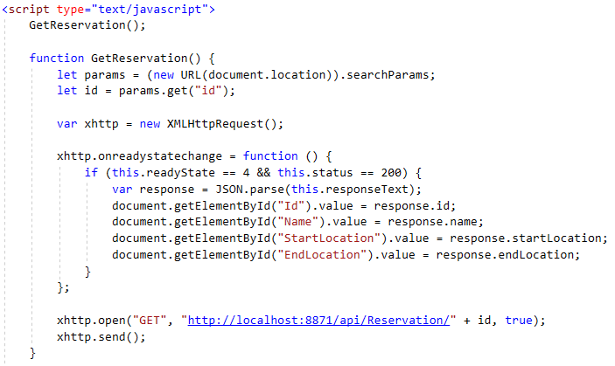
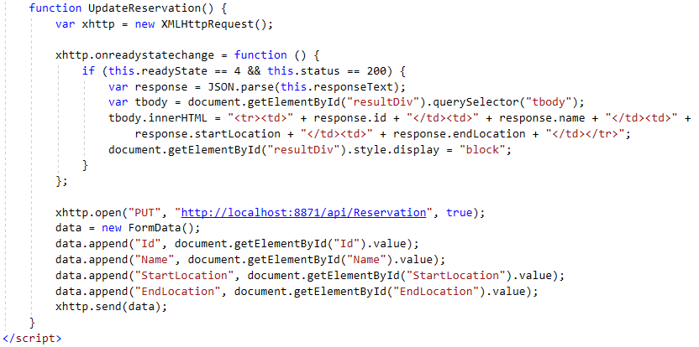
Update the existing data - 3
Using JavaScript XMLHttpRequest

Slide 35
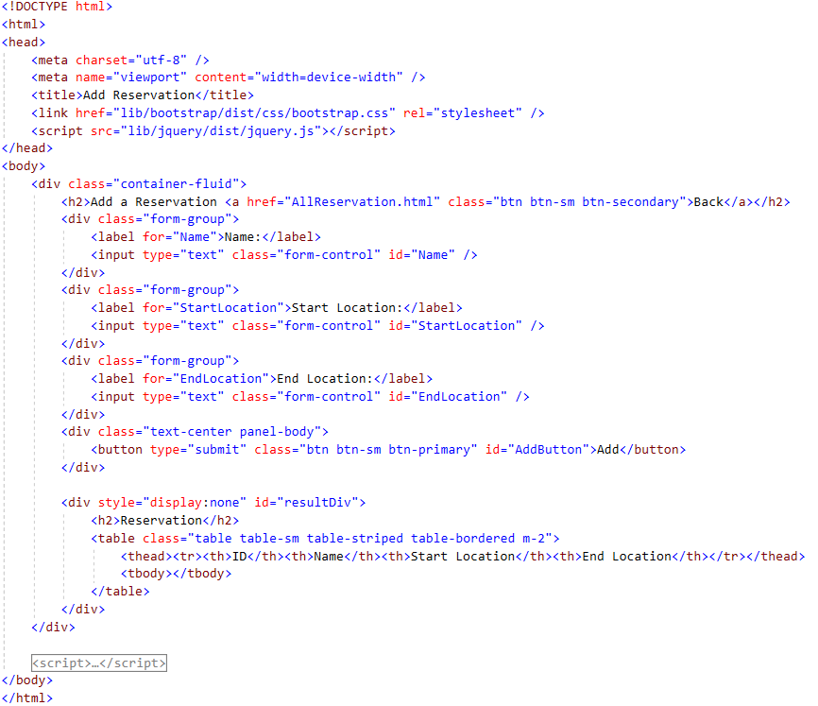
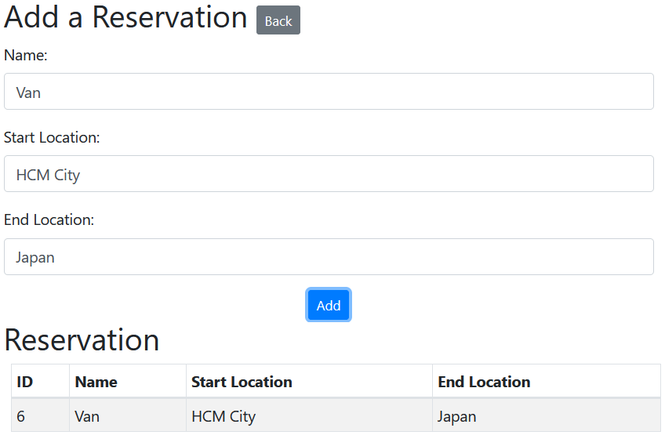
Create new data - 1
HTML for creating the reservation
Request will send to ASP.NET Core Web API

Slide 36
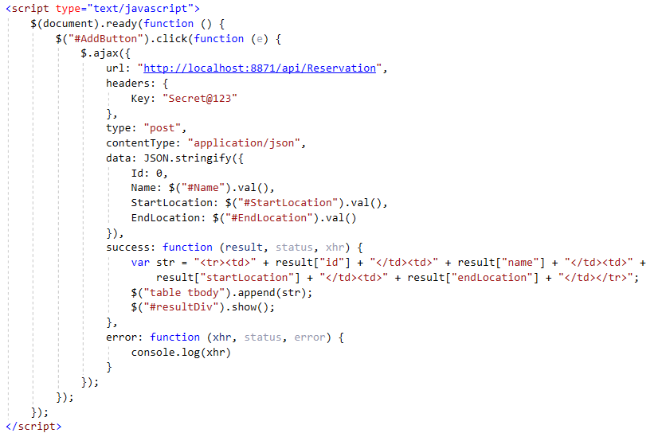
Create new data - 2
Using jQuery $.ajax() function to get the data by Id, then update

Slide 37
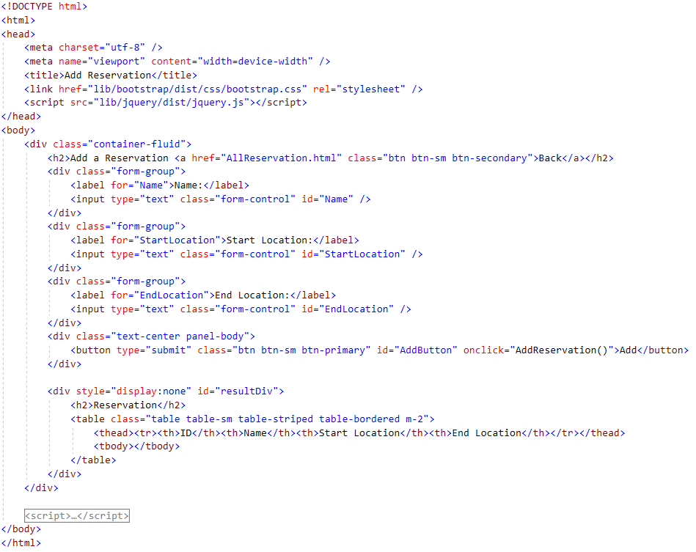
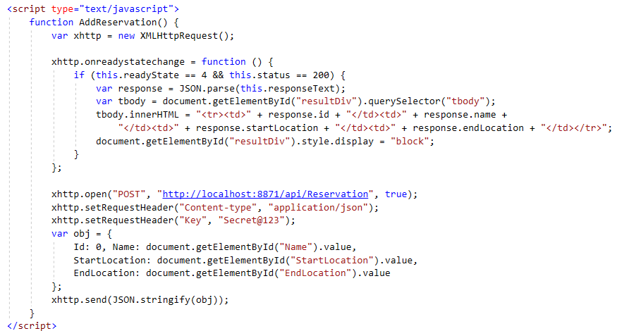
Create new data - 3
Using JavaScript XMLHttpRequest

Slide 38
Summary
The concepts were introduced:
JavaScript Introduction
jQuery Syntax
jQuery Selectors
jQuery Event Methods
AJAX (Asynchronous JavaScript And XML)
jQuery AJAX Methods
Demo ASP.NET Core Web API with JavaScript Client

